Slide 1

UK Train Rides Dashboard
DEPI3 - Data Analysis Power Bi

Slide 2
Team Members
Ahmed Essam Eldin Abd El Fattah
Ahmed Ibrahim Abdelhamid
Amr Essam Fathy
Eslam Mohamed Abd El Fattah
Reham Mahmoud Moustafa Shaarawy

Slide 3

TABLE OF CONTENTS
01
04
02
05
03
06
Team Members
Steps
Project Overview
Data Cleaning & Modeling
Data Description
CONCLUSION

Slide 4
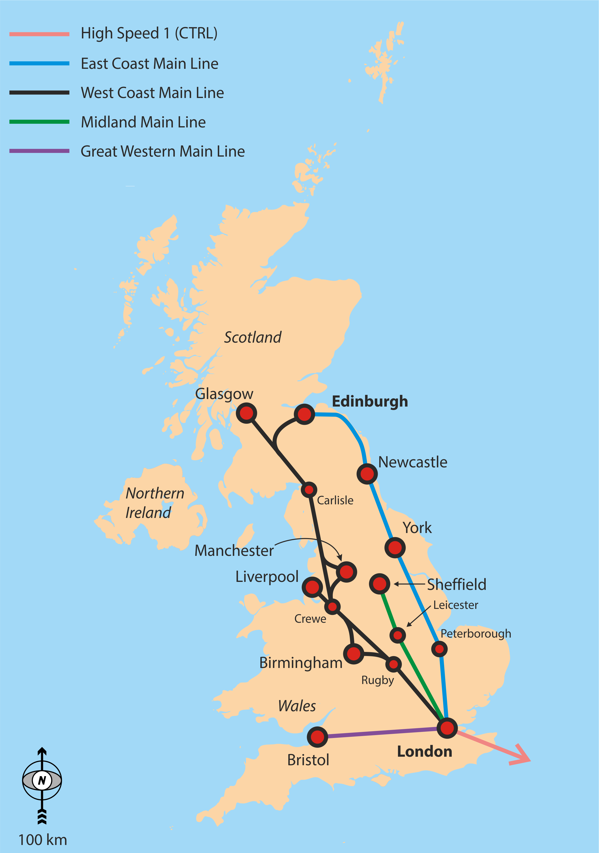
Project Overview
Our project focuses on analysis of UK railway operations from January to April 2024 using Power BI. Our goal is to provide key insights to improve service performance and increase passenger satisfaction.

Slide 5
Data Description
The original dataset is CSV file which consists of 18 columns. The file was imported into Power BI Desktop for analysis.

Slide 6
Steps
Cleaning
Modeling
Dax
Visuals
Reports
Dashboard

Slide 7
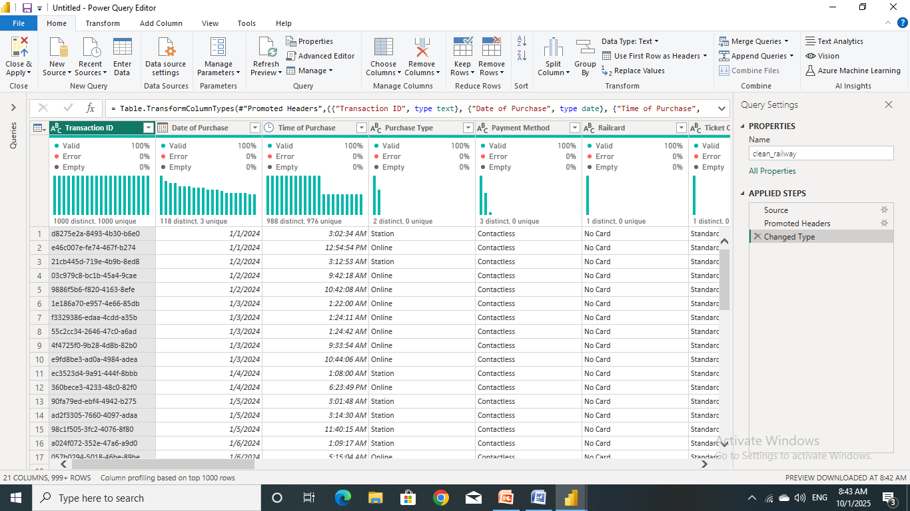
Data Cleaning
Power Query Editor (Before Cleaning)

Slide 8
Data Cleaning
The following steps were taken:
within budgetNo duplicated records were found.
Replace “None” in Railcard column with “No Card”.
Replace blank in Reason for Delay column with “No Delay”.
Replace “Weather” in Reason for Delay column with “Weather Conditions”.
Replace “Staffing” in Reason for Delay column with “Staffing shortage”.
Replace “Signal failure” in Reason for Delay column with “Signal Failure”.
Add new column called “Reservation Period In Days”.
Add new column called “Delayed In Minutes”.
Add new column called “Day of Journey”.

Slide 9
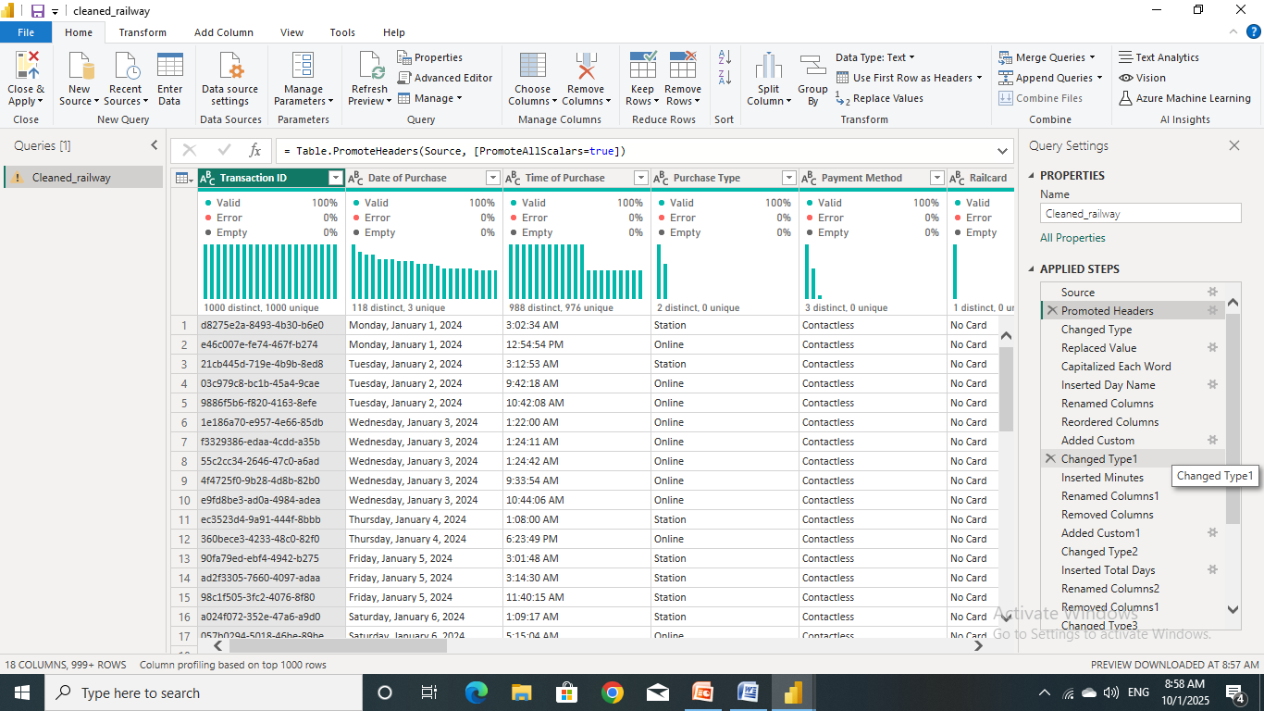
Data Cleaning
Power Query Editor (After Cleaning)

Slide 10
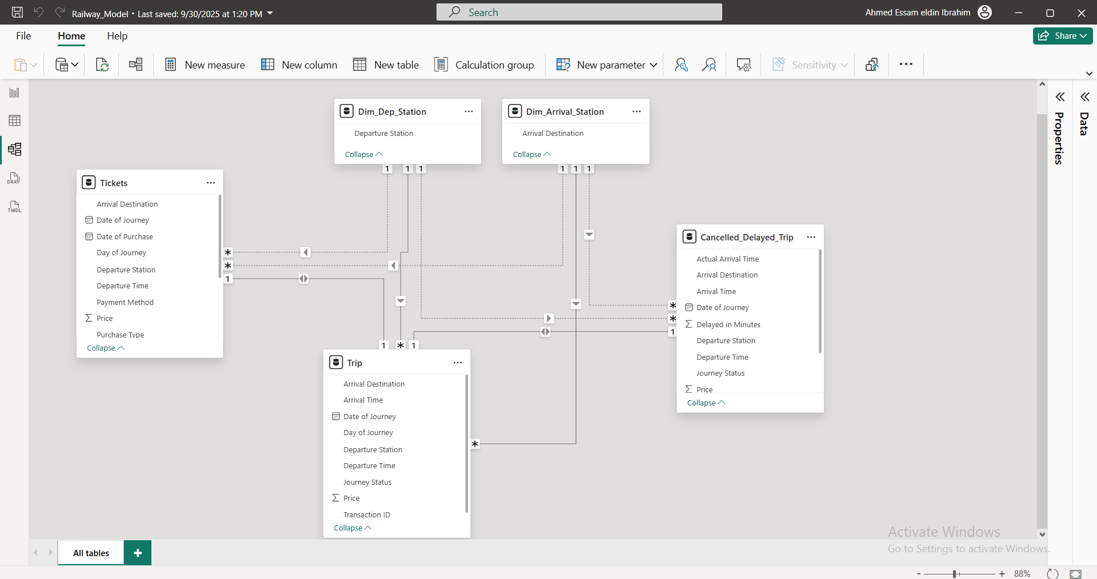
Data Modeling

Slide 11
DAX
The following steps were taken:
Total Trip = COUNT(Cleaned_railway[Transaction ID])
on_time_trip = CALCULATE([Total Trip],Cleaned_railway[Journey Status]="ON Time")
Delayed_trip = CALCULATE([Total Trip],Cleaned_railway[Journey Status]="Delayed")
Cancelled_trip = CALCULATE([Total Trip],Cleaned_railway[Journey Status]="Cancelled")
Delay_percentage = [Delayed_trip]/[Total Trip]*100
on_time_percentage = [on_time_trip]/[Total Trip]*100
Cancelled_percentage = [Cancelled_trip]/[Total Trip]*100

Slide 12
DAX
The following steps were taken:
avg_delay_duration = AVERAGE(Cleaned_railway[Delayed in Minutes])
max_delay_duration = MAX(Cleaned_railway[Delayed in Minutes])
min_delay_duration = MIN(Cleaned_railway[Delayed in Minutes])
total_revenue = SUM(Cleaned_railway[Price])
avg_price = AVERAGE(Cleaned_railway[Price])
max_price = MAX(Cleaned_railway[Price])
min_price = MIN(Cleaned_railway[Price])

Slide 13
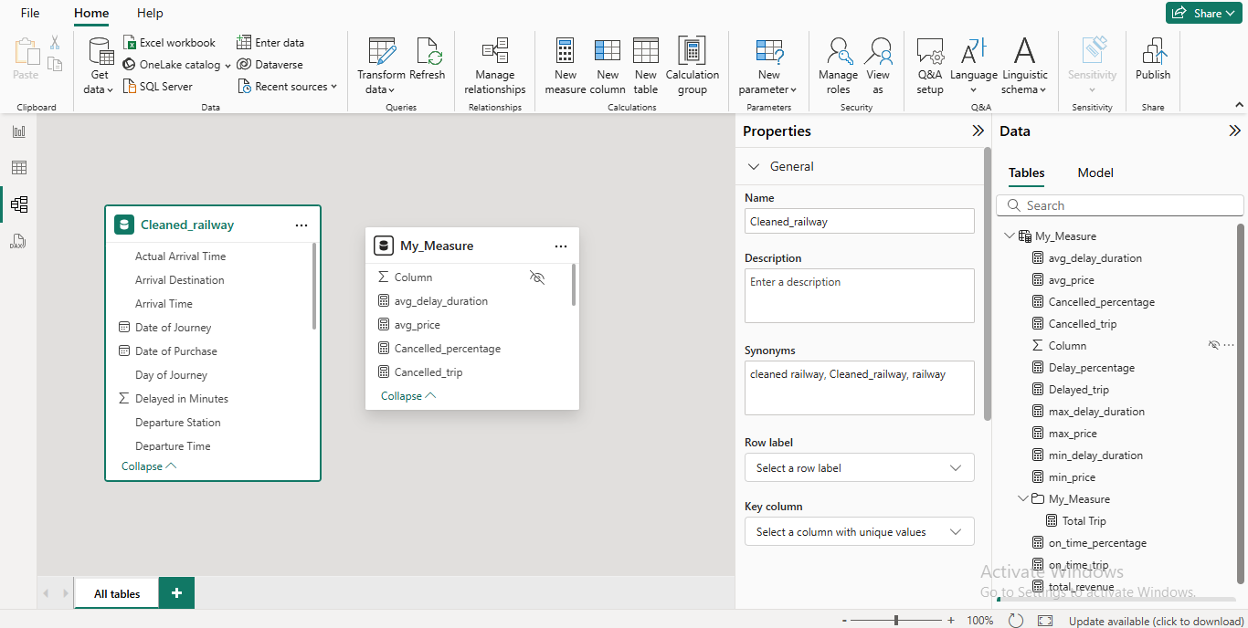
DAX

Slide 14
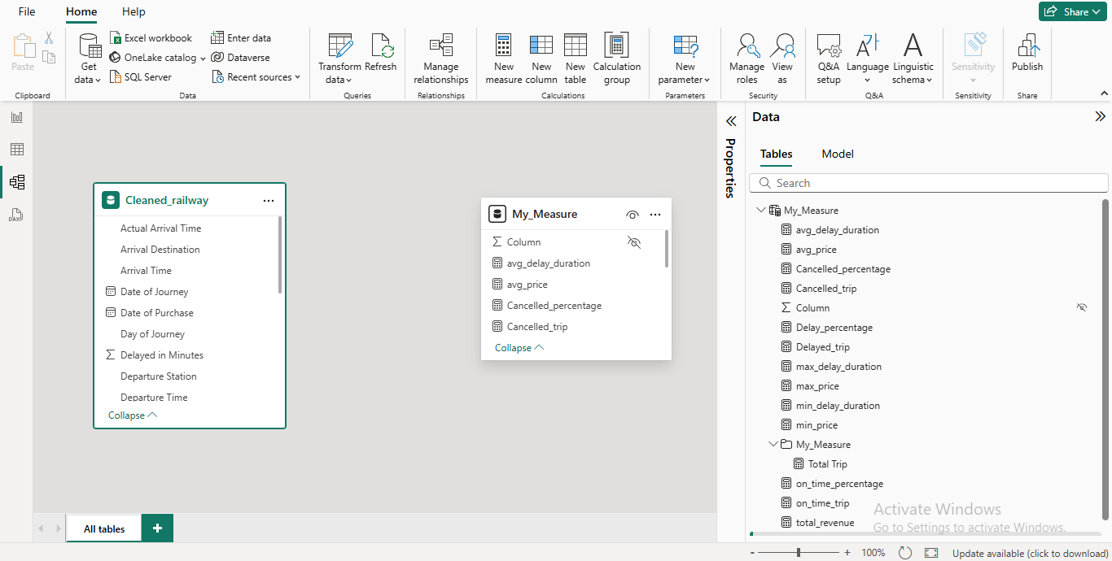
DAX

Slide 15
Insights
Ticket Sales
Total purchased ticket
Number of purchased ticket per week (trend)
What is total Revenue?
What is average ticket price by ticket type?
What is average ticket price by ticket class?
Passenger
What is the preferred way to purchase ticket?
What is the preferred method of paying for tickets?
What is passenger distribution by rail card?
What is passenger distribution by ticket class?
What is passenger distribution by ticket type?
What is maximum, minimum, average preservation period?

Slide 16
Insights
Station and routes
How many departure station?
How many arrival station?
How many route What are the most popular routes?
What are peak travel day?
What are peak travel hour?
Performance
Number of on time, delayed, cancel trip?
Reason for delayed Reason for cancelled
Trip status by route
What is maximum, minimum, average delayed period?
Percentage of refund Requests

Slide 17
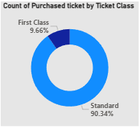
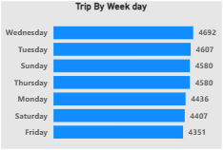
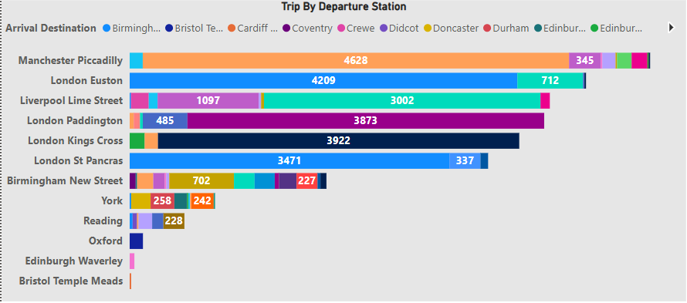
Visuals

